Slide 1



What is OS?

Slide 2
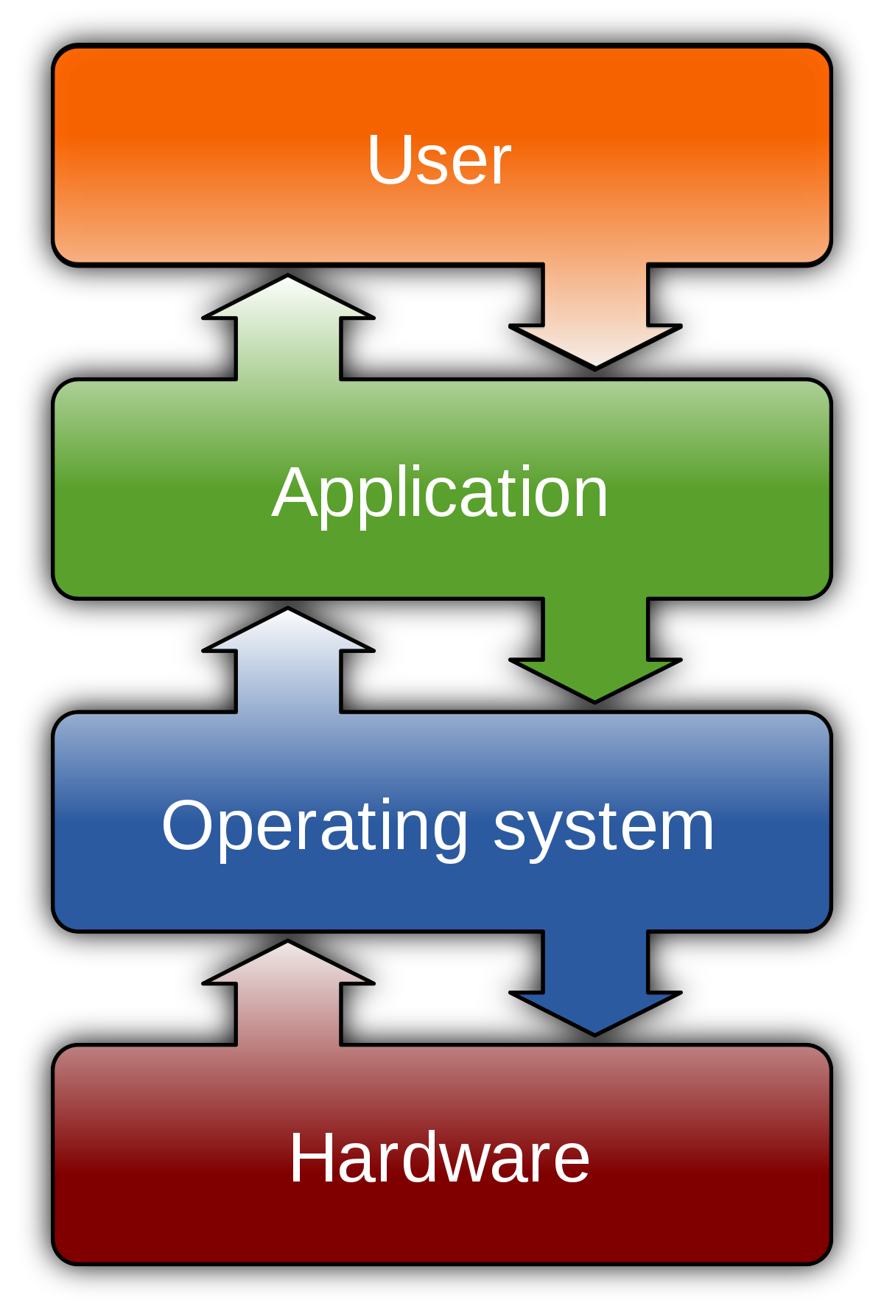
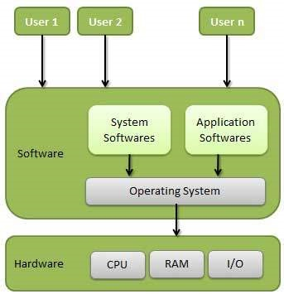

Slide 3
Types Of Operating Systems
Desktop OS (Windows7, Ubuntu)
Server OS (ADDS, DNS, DHCP, Mail, File, Chat, VOIP, Print)
Network OS (Router, Switch)
Network Security OS (Firewall)
Embedded OS (Robot, Drone, NVR, DVR, IP Camera, IP TV)

Slide 4
OS Vendors

Slide 5
Desktop OS
Windows 98
Windows XP
Windows Vista
Windows 7
Windows 8.1
Windows 10

Slide 6
Server OS
2003
Windows Server 2003
2003
Windows Server 2003 R2
2008
Windows Server 2008
2008
Windows Server 2008 R2
2012
Windows Server 2012
2012
Windows Server 2012 R2
2016
Windows Server 2016
2019
Windows Server 2019

Slide 7

Apple OS
Mac OS X Lion
Mac OS X Leopard
Mac OS X Tiger
Mac OS X Panther
IOS

Slide 8
Linux OS
Ubuntu Desktop Version
Ubuntu Server Version
Redhat
CentOS

Slide 9
Work of Operating System
Program Management
Memory Management
File Management
User Interface
Device Management
Security and Access Control
Error Handling and Logging

Slide 10
How to connect 0/1(Digital Signal) and Human?

Slide 11

ASCII American Standard Code for Information Interchange

Slide 12
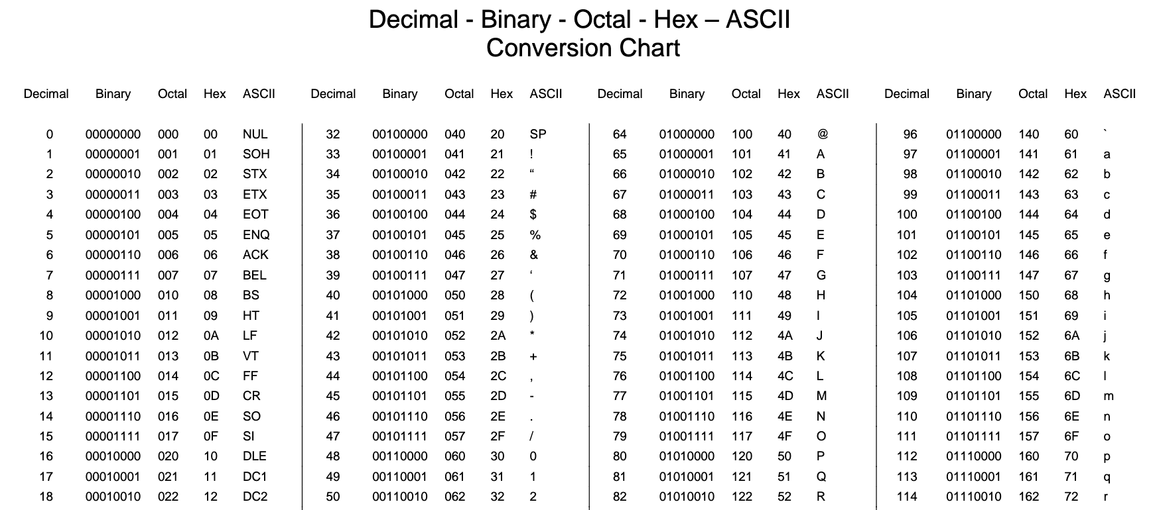

Slide 13
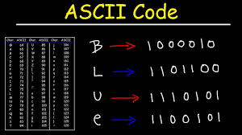
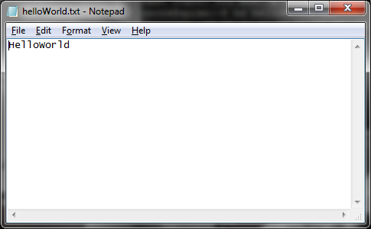
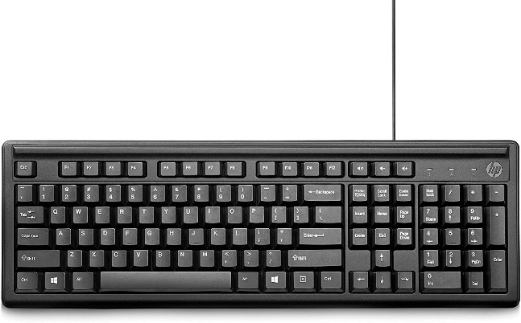
ASCII
Input
ASCII Code
Out Put

Slide 14
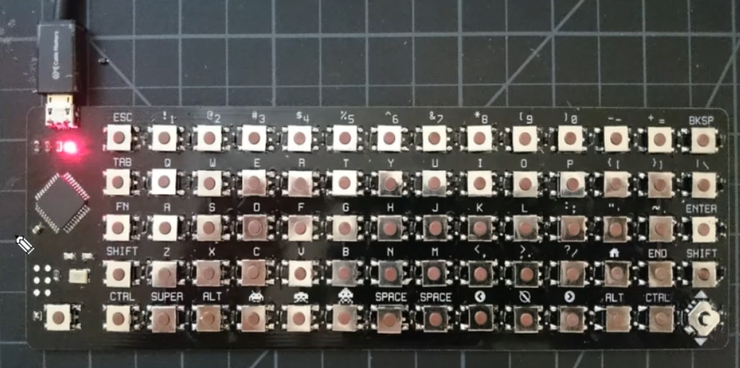

Slide 15
Digital Signal (B)
1 | 0 | 0 | 0 | 0 | 0 | 1 | 0

Slide 16
User Interface
Graphical User Interface (GUI)
Command-Line Interface (CLI)

Slide 17
What is Linux?

Slide 18
History Of Linux
Linux, operating system created in the early 1990s by Finnish Software Engineer Linus Torvalds and the Free Software Foundation (FSF)
American software developer Richard Stallman and the FSF made efforts to create an open-source UNIX-like operating system called GNU.
Stallman and the FSF started by creating utilities for the operating system first. These utilities were then added to the Linux kernel to create a complete system called GNU/Linux or less precisely just Linux.

Slide 19


Linus Torvalds
Richard Stallman

Slide 20
What is Linux?
Linux is an open source operating system that is made up of the kernel, the base component of the OS, and the tools, apps, and services bundled along with it.

Slide 21
Linux is a kernel
Linux Distribution is a Computer Operating System
Based on Unix
Heavily used for Servers
Good For Developers

Slide 22
Advantages of Linux
Free and Open Source
Security
Lightweight infrastructure
Multi User/Testing OS
Hardware Support
Software Update
Flexibility

Slide 23
Open Source Close Source

Slide 24

Open Source
Denoting software for which the original source code is made freely available and may be redistributed and modified.

Slide 25
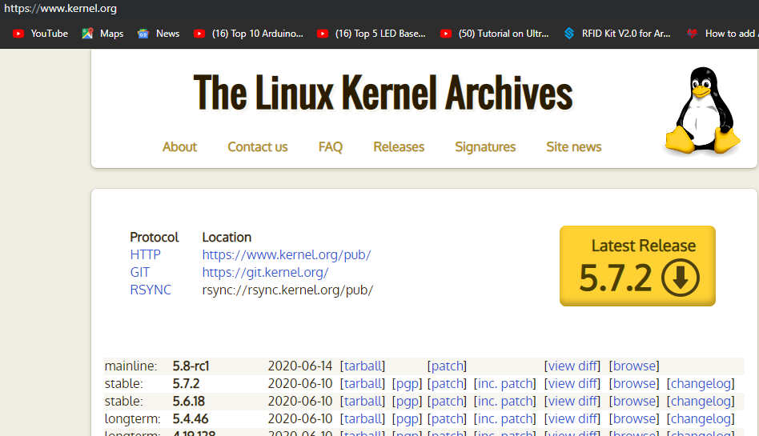

Slide 26
Source Code
Complier
Object Code

Slide 27

Close Source
Closed source software is software that holds the source code safe and encrypted. Meaning, the user can’t copy, modify, or delete parts of the code without some type of consequence. It can go from voiding the warranty to even legal repercussions.

Slide 28
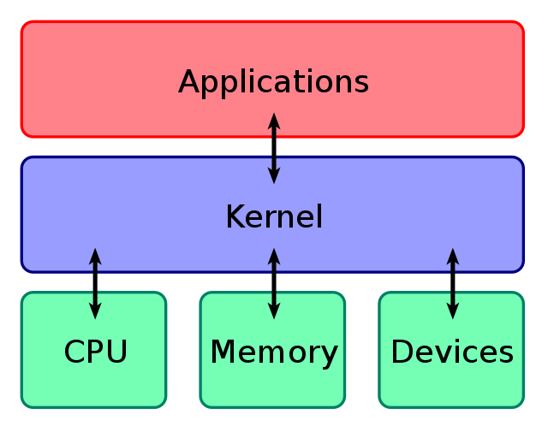
What is the Linux kernel?
The Linux kernel is the main component of a Linux operating system (OS) and is the core interface between a computer’s hardware and its processes.

Slide 29
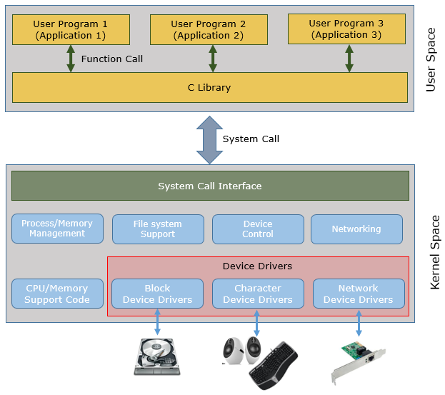
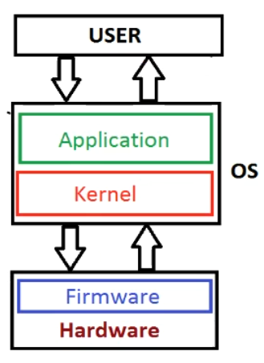

Slide 30
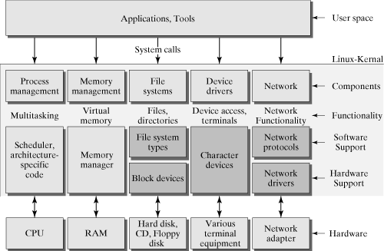

Slide 31
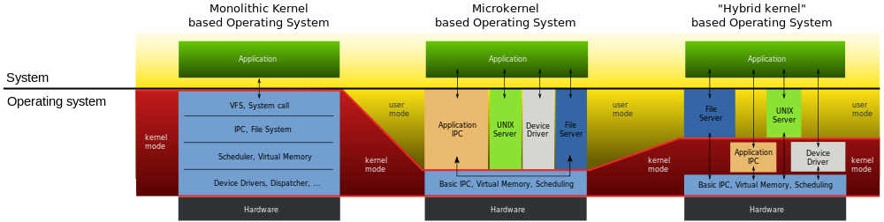
Types Of Kernel

Slide 32
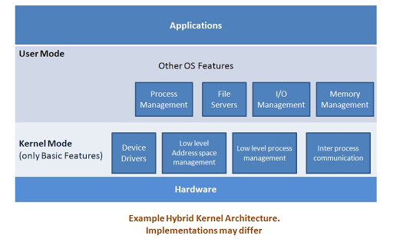
Hybrid Kernel

Slide 33
Linux Shell (Command-line interpreter)
The shell acts as an interface between the user and the kernel. Similar with command prompt in windows.
User ကနေပေးပို့လိုက်တဲ့ လုပ်ဆောင်ချက် အမှားတွေကိုလဲ shell က တားဆီးပေးတယ်။

Slide 34
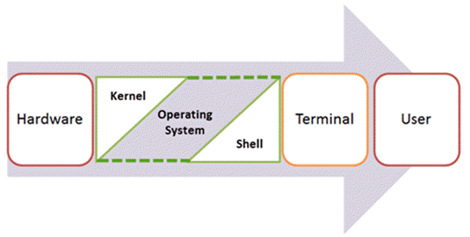

Slide 35
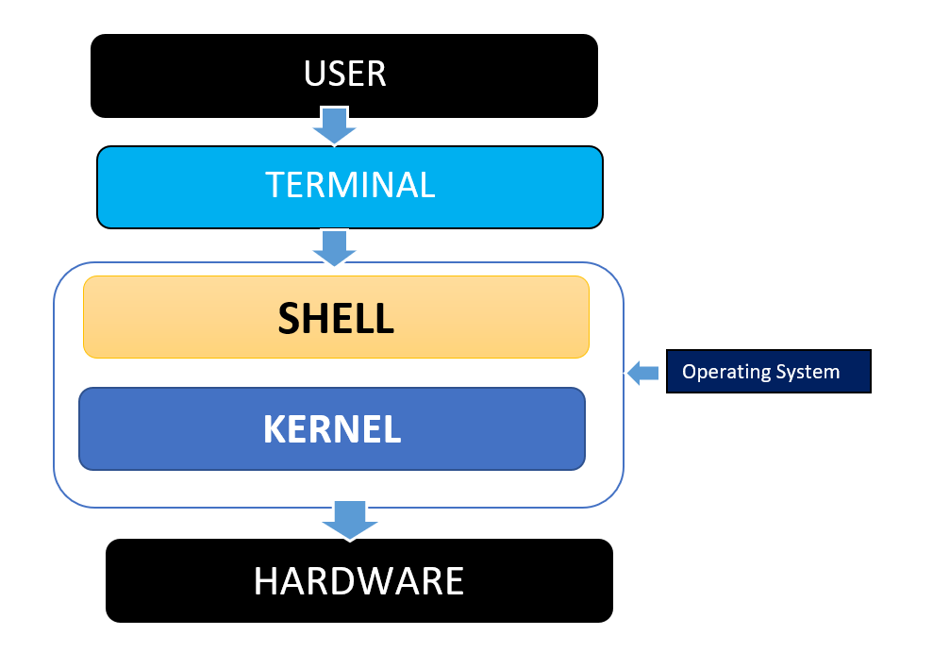

Slide 36
Interpreter
Shell Script
Shell
Kernel
mkdir
BASH
SH
CSH

Slide 37
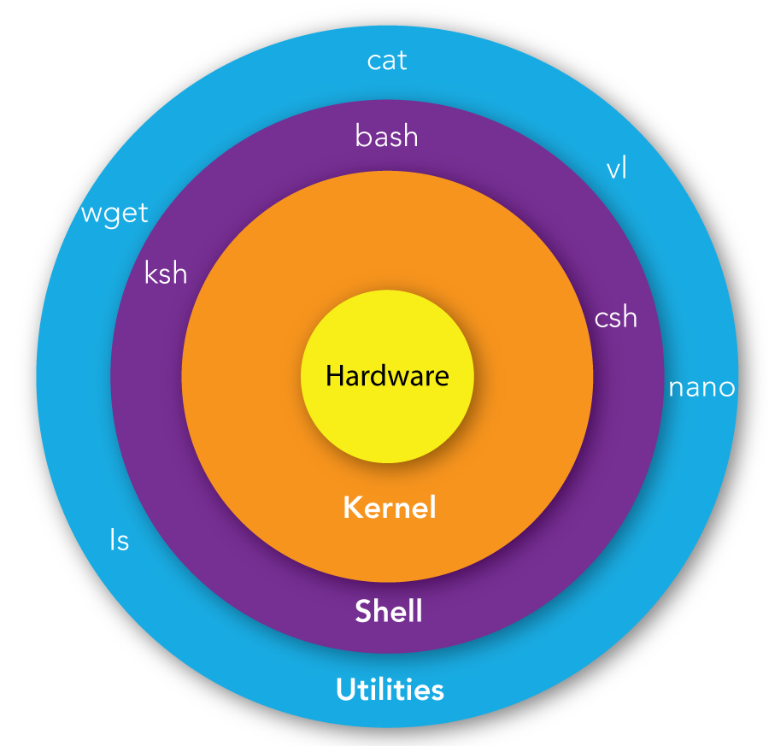
Linux Shell (Command-line interpreter)
Bourne shell
Korn Shell
Bourne Again shell
C Shell
Linux architecture

Slide 38
Shell Script (command)
/bin
/sbin
/usr/bin
/usr/sbin

Slide 39




Linux Distributions (Linux Distros)
Linux distro is a version of the open source Linux Operating System
Debian Linux
Slackware Linux
RedHat Linux
Ubuntu Linux
https://upload.wikimedia.org/wikipedia/commons/8/83/Linux_Distribution_Timeline_27_02_21.svg

Slide 40
Linux for Server
Red Hat Enterprise Linux
CentOs
Ubuntu Server
Suse Enterprise Linux
Fedora
Rocky

Slide 41
Linux for Personal Use
Ubuntu
Fedora
Open Suse
Linux Mint

Slide 42
Linux for Security
Kali Linux
Parrot
Arch

Slide 43
Desktop Environment
Linux offers a variety of desktop environments, each providing a different user interface, feature set, and visual style.
XFCE
GNONE
KDE
MATE / budgie
https://geekflare.com/linux-desktop-environment/

Slide 44
Package Manager
A package manager reduces the complexity for the end-user by automating the process of obtaining, installing, upgrading, and removing packages and their dependencies.

Slide 45
Linux Package Management
 | Debian | Redhat
Software Packages | .deb | .rpm
Package Manager | dpkg | rpm
 | apt | yum/dnf
apt = advance package tool
yum = yellowdog updater modified
dnf = dandified YUM

Slide 46
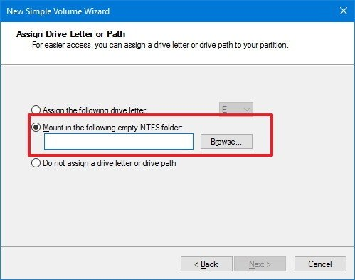
Mount

Slide 47
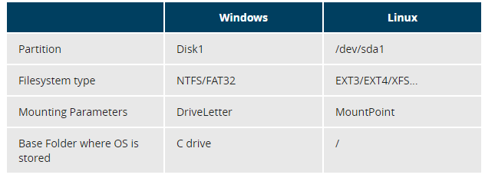

Slide 48
Windows File System
Feature | FAT32 | NTFS
Max. File Name | 8.3 Characters | 255 Characters
Max. File size | 4GB | 16 TB
File/Folder Encryption | No | Yes
Compression | No | Yes
Disk Quotas | No | Yes
Compatibility | Win95/98/2K/2K3/XP | Win NT/XP/Win7/Win10

Slide 49
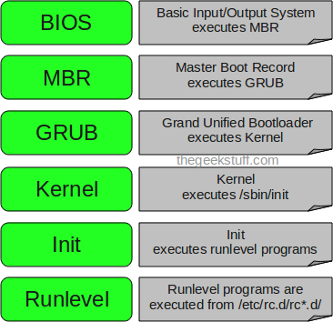
Linux Boot Process

Slide 50
BIOS
BIOS stands for Basic Input/Output System
Performs some system integrity checks
Searches, loads, and executes the boot loader program.
Legacy BIOS
UEFI (Unified Extensible Firmware Interface)

Slide 51
MBR
MBR stands for Master Boot Record.
It is located in the 1st sector of the bootable disk. Typically /dev/hda, or /dev/sda
MBR is less than 512 bytes in size. This has three components 1) primary boot loader info in 1st 446 bytes 2) partition table info in next 64 bytes 3) mbr validation check in last 2 bytes.
It contains information about GRUB.
So, in simple terms MBR loads and executes the GRUB boot loader.

Slide 52
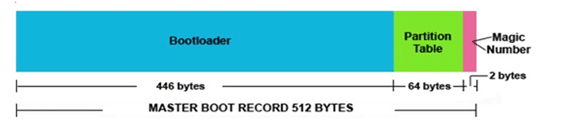
MBR
The bootloader in Linux serves as a critical component in the startup process of our Operating systems.
Legacy BIOS
UEFI (Unified Extensible Firmware Interface)

Slide 53
Disk Types = Partition Table
MBR = MS-DOS Partition Table (Bootable)
MBR = Support 2 TB Storage
GPT = GUID Partition Table (Non Bootable)
GPT = Support Lager Than 2 TB Storage

Slide 54
Disk Types = Partition Table
MBR (Legacy) 2TB
GPT (UEFI) More 2TB

Slide 55
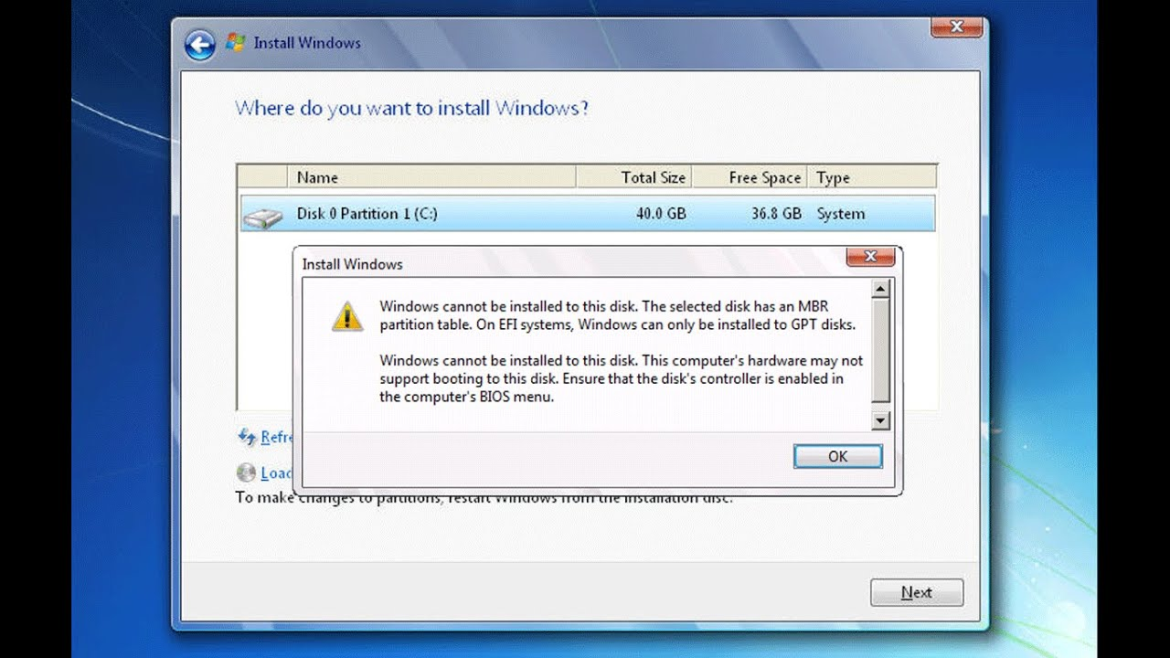

Slide 56

Create Partition For MBR in Linux
1. /boot
2. swap
3. /root

Slide 57
Create Partition For GPT in Linux
1. /boot
2. /boot/efi
3. swap
4. /root

Slide 58
GRUB
GRUB stands for Grand Unified Bootloader.
If you have multiple kernel images installed on your system, you can choose which one to be executed.
GRUB displays a splash screen, waits for few seconds, if you don’t enter anything, it loads the default kernel image as specified in the grub configuration file.
So, in simple terms GRUB just loads and executes Kernel and initrd images.

Slide 59
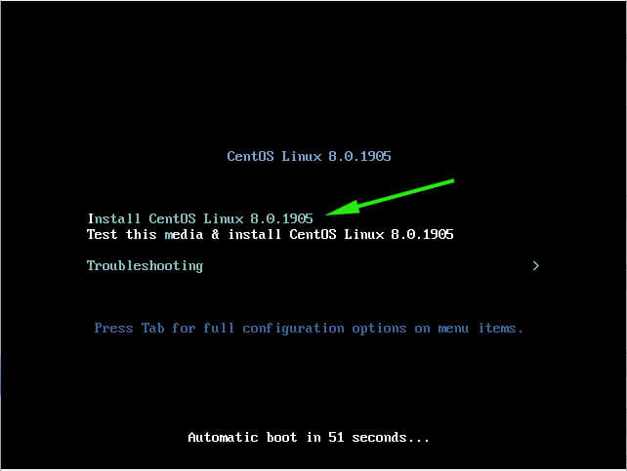

Slide 60
Boot Loader File
Kernel Image
/
/boot
Initial RAM Disk Image

Slide 61
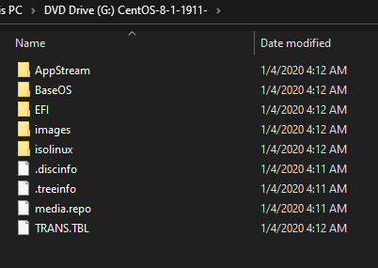
Linux CD

Slide 62
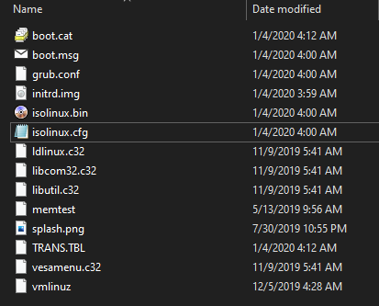
Initial
boot
background
Arrow key
Kernel IMG

Slide 63
Kernel
Mounts the root file system as specified in the “root=” in grub.conf
Kernel executes the /sbin/init program
initrd stands for Initial RAM Disk.
It also contains necessary drivers compiled inside, which helps it to access the hard drive partitions, and other hardware.

Slide 64
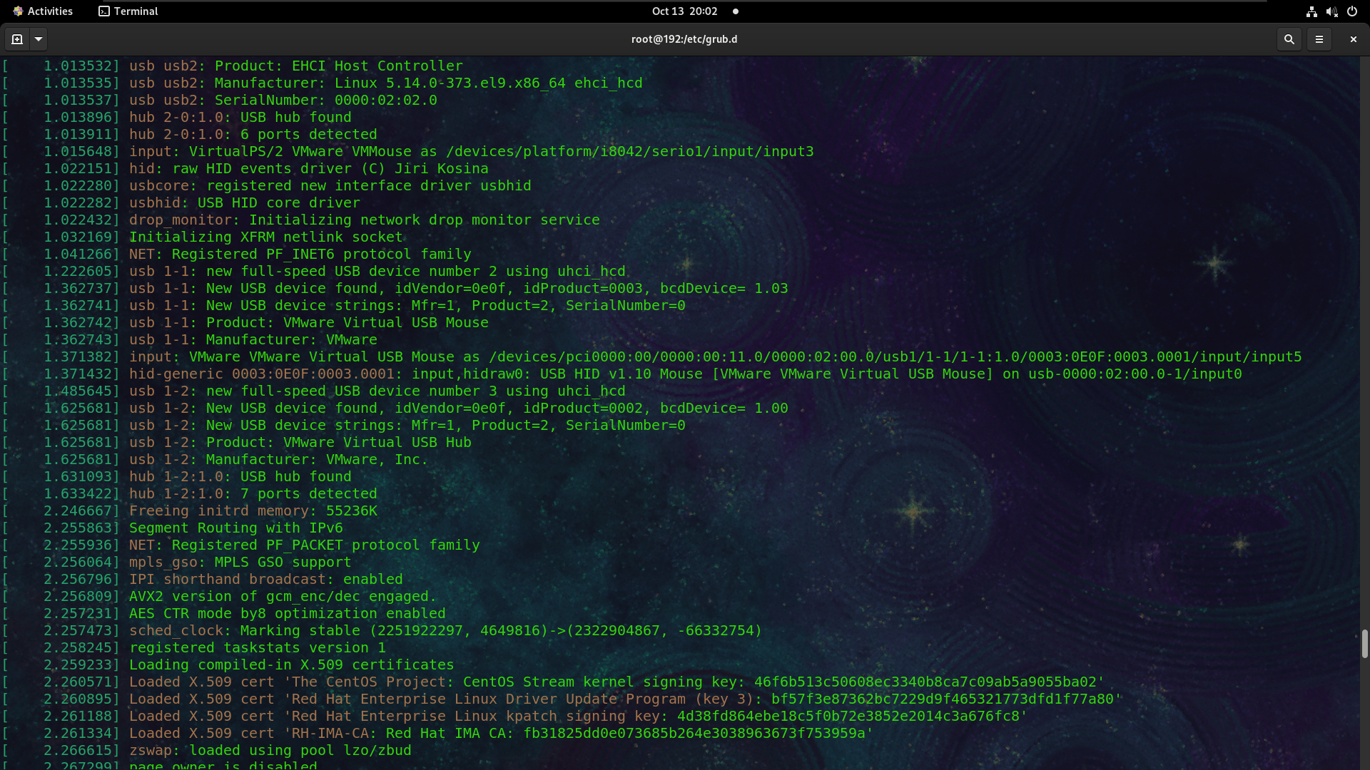
dmesg

Slide 65
Init
Looks at the /etc/inittab file to decide the Linux run level.
Init identifies the default initlevel from /etc/inittab and uses that to load all appropriate program.
Execute ‘grep initdefault /etc/inittab’ on your system to identify the default run level

Slide 66
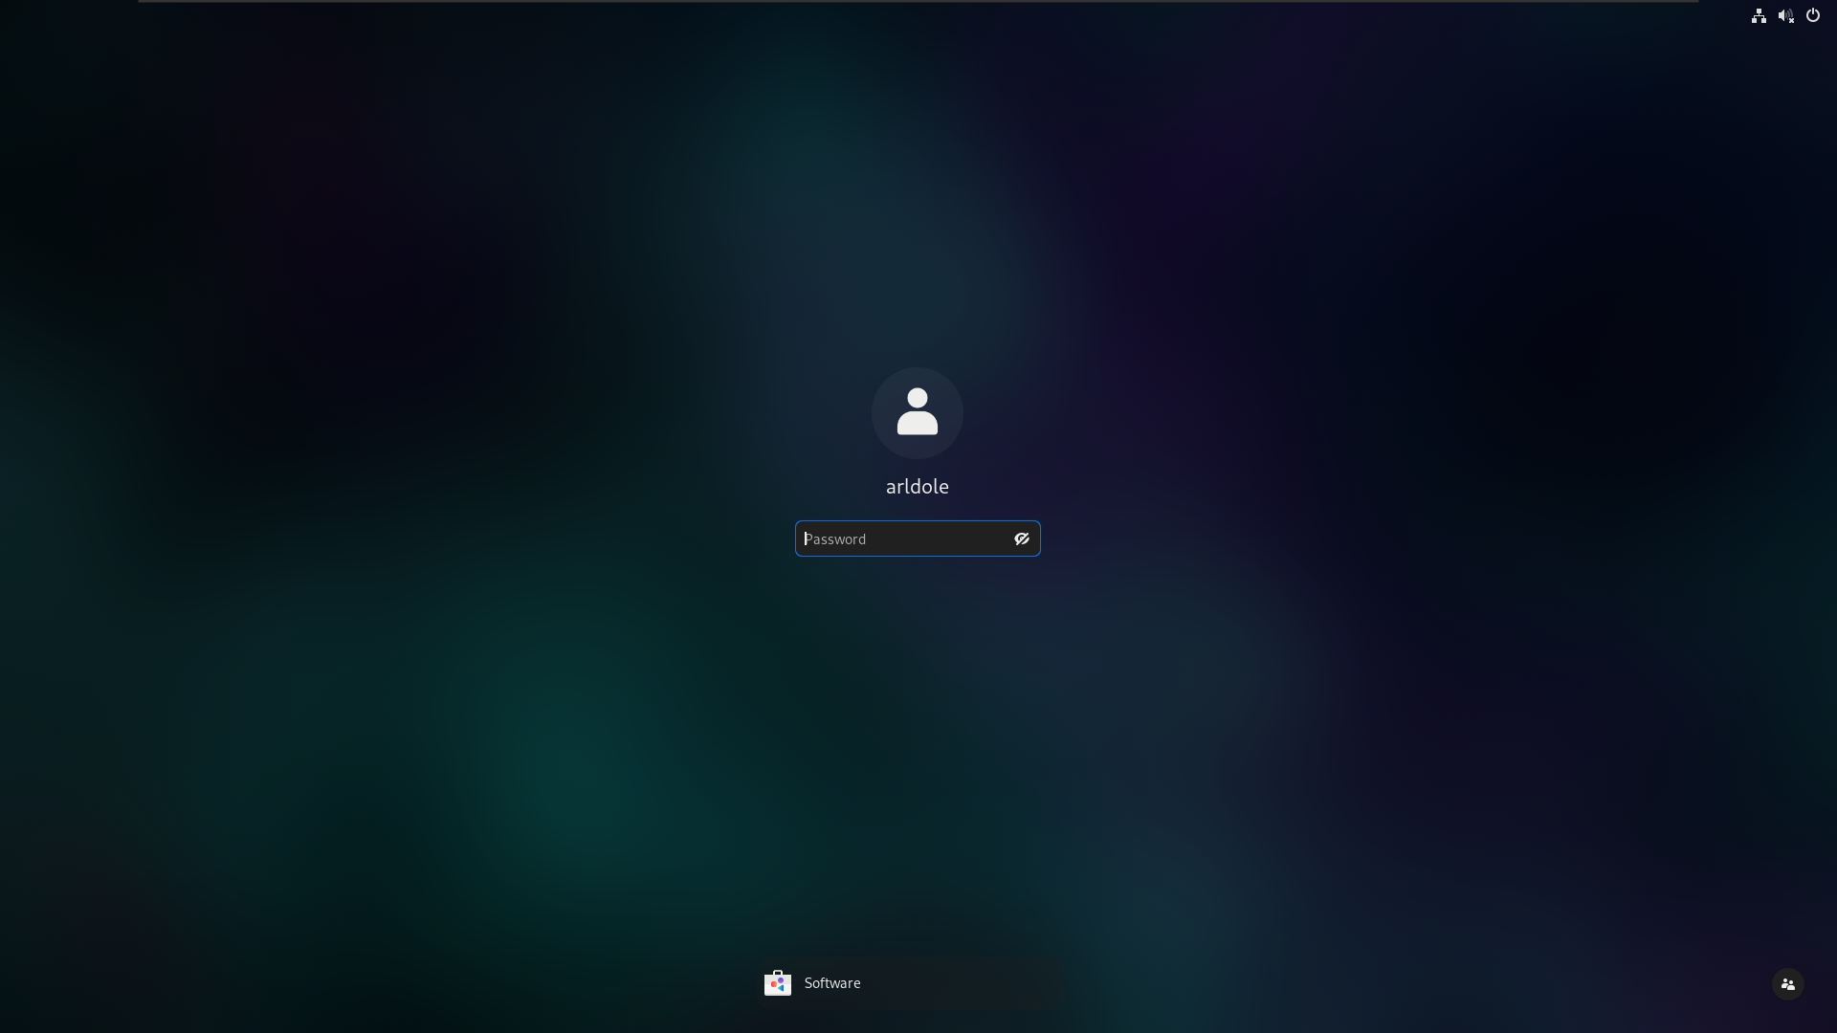
Run Level
Login
Root user / Super user
Normal user

Slide 67
Linux Terminal
Current Location
[root@arldole ~ ]# Privilege level root level
[user@arldole ~ ]$ user level
User Name
Host Name

Slide 68
~ = User Home Directory
# = Root Home Directory
/home/user = User Home Directory
/root = Root User Home Directory

Slide 69

About Linux Directory Structure

Slide 70
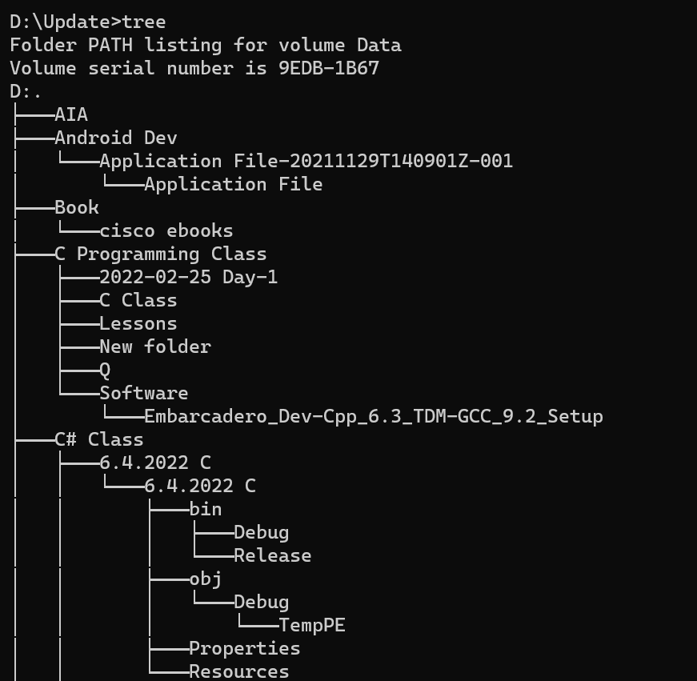
Windows Tree Structure

Slide 71
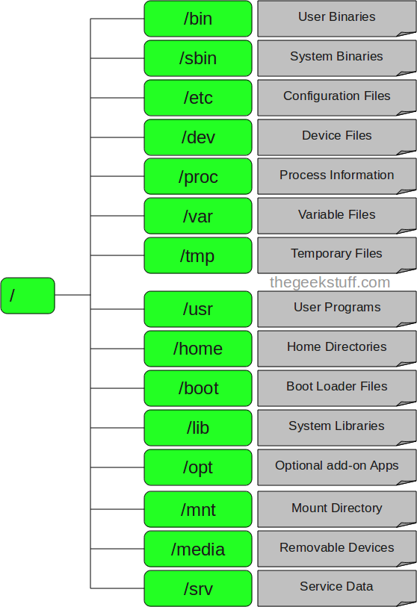
Directory Hierarchical System

Slide 72
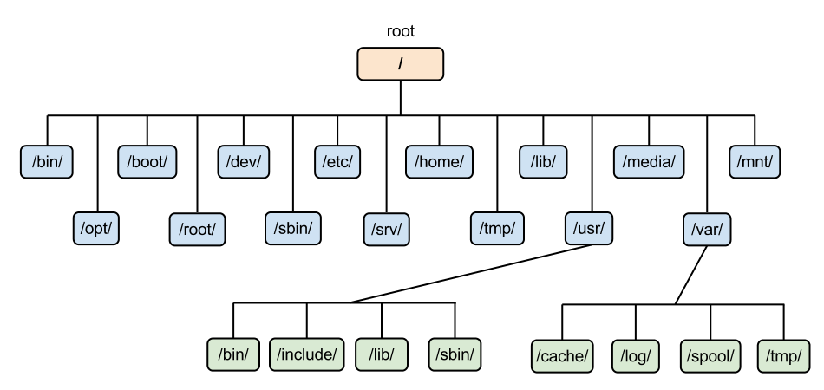

Slide 73
Linux Command Syntax
&& (Double ampersand ) pwd && ls
; (Simicolon) pwd; ls
| (Pipe) cat /etc/passwd | grep root
|| (Double Pip) cmatrix || sudo apt install cmatrix.
Double Quote “”
Single Quote ‘’
Echo *

Slide 74
File Viewing & Edit (head/tail/less/more/grep/tac)
cat = View Contents of a file
head = Get First 10 lines of a content
tail = Get tail 10 lines of a content
less = View Less
more = View more
grep = Search for a specific String

